Slide 1
Restaurant FInder
Created by Maxwell Oldshein

Slide 2
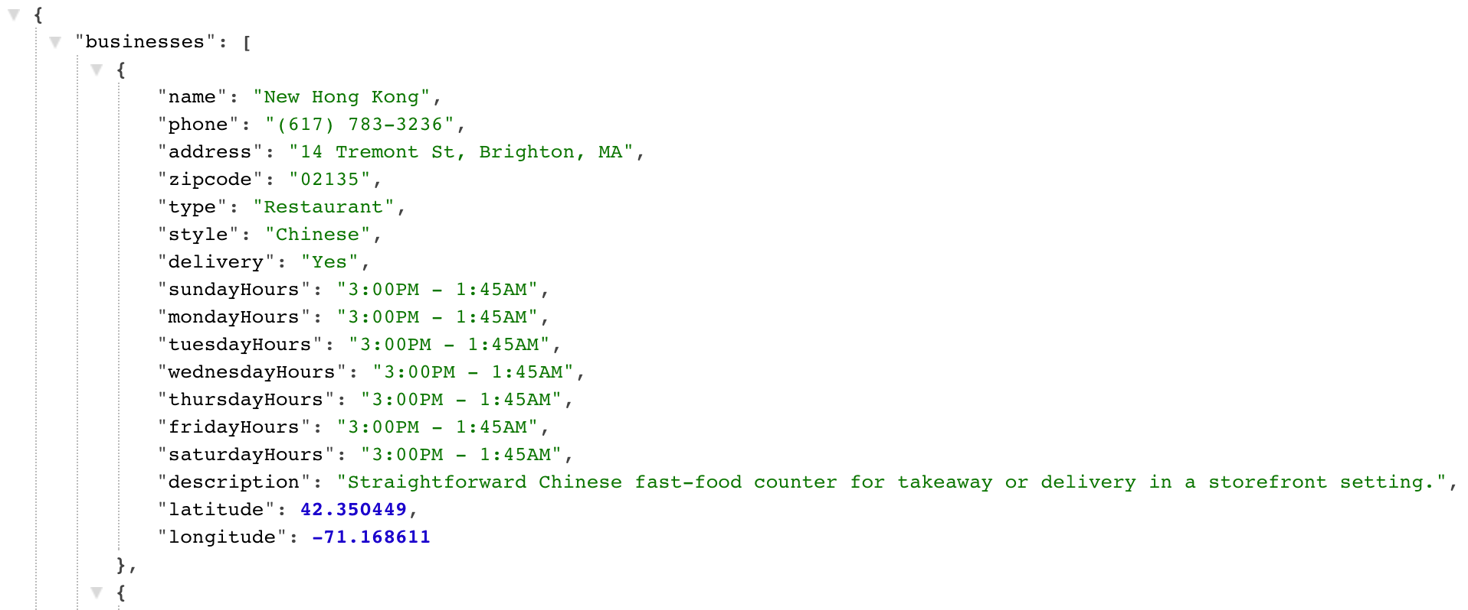
The json data
For my JSON data, I compiled some information on some local bars and restaurants
Some of the data that I collected was the business’s name, the business’s address, the business’s phone number, whether the business offers delivery service, and the business’s hours of operation.
I hosted this JSON data on my personal website, at the following address: http://maxwelloldshein.com/JSON/restaurants.json

Slide 3
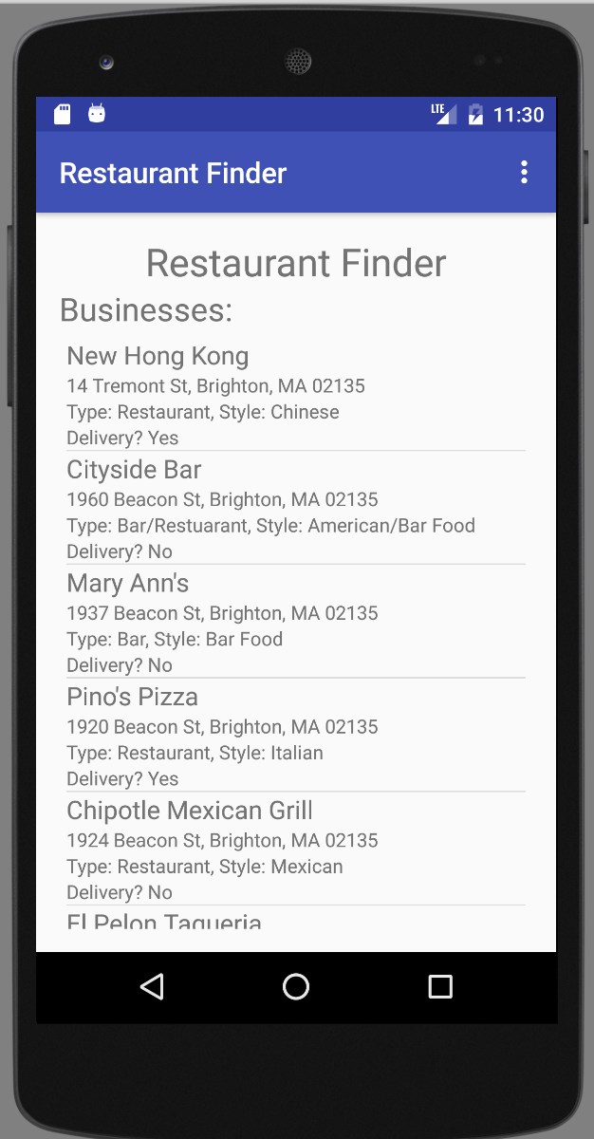
The main activity
To start, I had the user land on an activity that pulls down all of the businesses from the JSON file on my personal website and populates them into a ListView.
I decided to use a CustomAdapter to display the business’s name, address, type (restaurant, bar, or both), cuisine style, and whether they deliver or not.
From the main activity, you can also use the menu in the navigation bar to search for restaurants by name, zip code, and whether they offer deliver or are pickup only.

Slide 4
Search by name
With the search by name function, you can search for restaurants specifically by name.
For example, a search for “El”, will return El Pelon, that way you don’t have to remember the the business’s full name.

Slide 5
Search by Zipcode
You can also search by zip code.
For example, a search for “02467” will return all the restaurants in the Chestnut Hill zip code area.

Slide 6
Search By Delivery service
You can also search by whether or not you want to see restaurants that deliver or not.
For example, selecting the “Yes” radio button will only return you restaurants that offer delivery service.
On the other hand, selecting the ”No” radio button will only return you restaurants that are pickup only.

Slide 7
The map Activity
When you select a ListView item, you are taken to a map activity that focuses in on the business you tapped on.
You can also scroll around and see other businesses nearby
Tapping on the marker will give you a preview of the businesses information in a window above it.
Tapping on the information window will take you to a new activity that displays the full information of the business.
Note that the phone number is clickable, so you can call the business from right inside the application.

Slide 8
Thanks for Listening!
Questions? Comments?

